Slide 1

Bus Ticket booking system
Group Members
Umesh Raj Joshi(023-787)
Yubaraj Karki(023-785)
Pratham Aryal(023-796)

Slide 2
Table of contents
Introduction
Problem Statement
Objective
Scopes of the project
Used SDLC model
Feasibility analysis
Flowchart
Use case diagram
Gannt chart
Expected outcome
conclusion
Reference

Slide 3
Introduction
Online ticket booking system is the process whereby consumer directly book the ticket online. Online ticket booking system is the process of booking ticket from merchants who sell on internet. We are diligently crafting a comprehensive booking system leveraging the flexibility and efficiency of the C++ programming language.

Slide 4
Problem Statement
In early ticket booking system, many times information of booked ticket were lost.
Currently, the ticket booking company and ticket counter book their ticket in paper which is more complicated to the customer.

Slide 5
Objective of the project
Our aim
To data secure and confidential and solve the current issue of ticket booking system.
The goal
To minimize the paper work which is used during the ticket booking and also create easy interface for customer for booking their tickets.

Slide 6
Scope of the project
Ticket booking
Ticket status and road status
User friendly
Allow users to book ticket easily and don’t have any kinds of problems with booking a ticket.
Allow users to check the details of the booked tickets and also the roads status for the past years.
The system is very user friendly and easy to use for anyone.

Slide 7
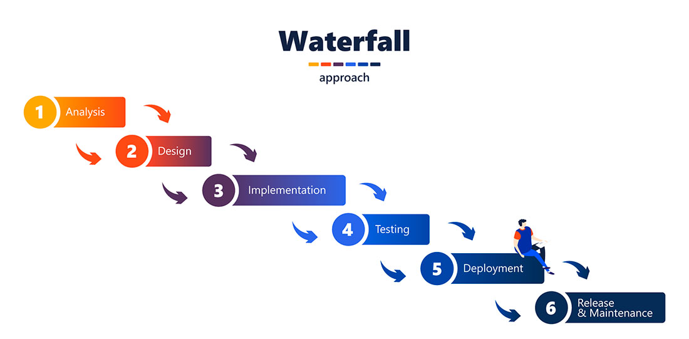
Used SDLC model
The Waterfall methodology also known as the Waterfall model is a sequential development process that flows like a waterfall through all phases of a project (analysis, design, development, and testing, for example), with each phase completely wrapping up before the next phase begins.

Slide 8
Feasibility Analysis
1. Technical feasibility
2. Operational feasibility
3. Scheduling feasibility
4. Economic feasibility
5. Legal feasibility

Slide 9
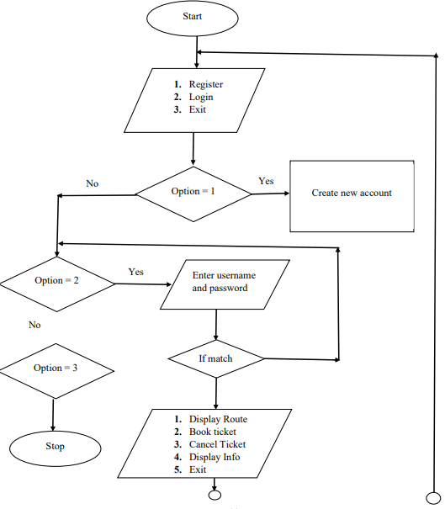

Slide 10
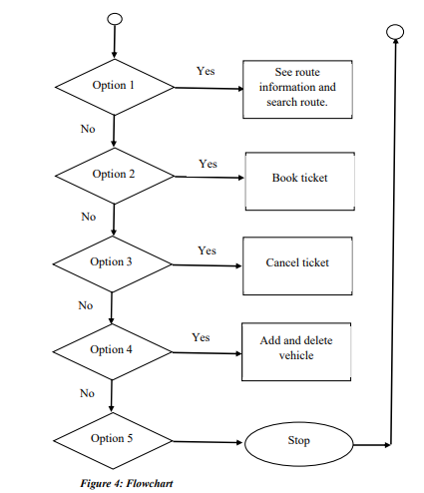

Slide 11
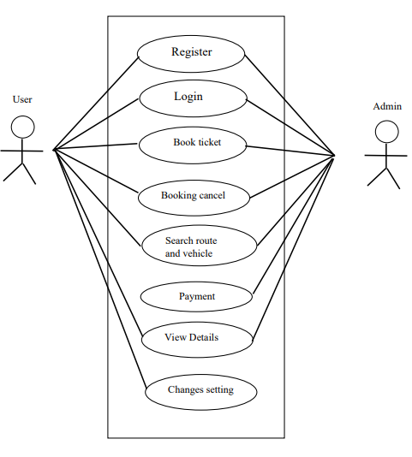

Slide 12
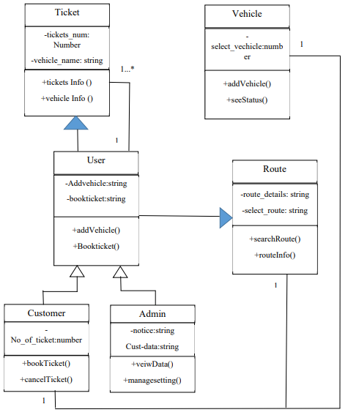

Slide 13
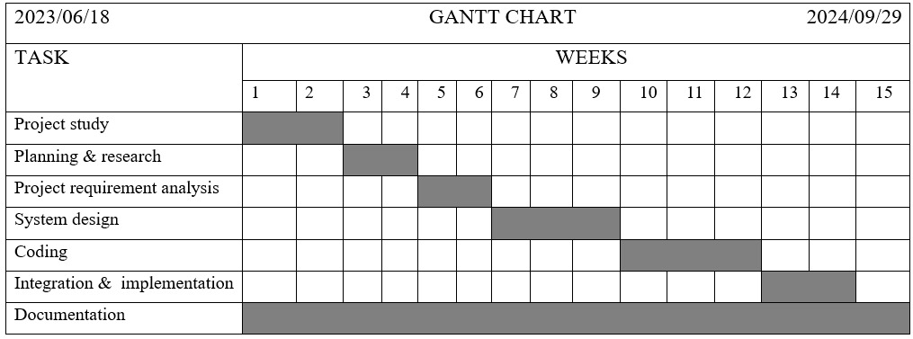

Slide 14
Expected Outcome
Implement functions for verifying username-password authentication and role-based authorization to restrict access to specific functionalities.
Tracking available ticket, update route, selecting vehicle and customer review also manage the ticket counter in a proper way.
Online payment can easily done through this system and validate transaction details and update available ticket and vehicle.

Slide 15
Conclusion
While developing the project we have learnt a lot about online ticket booking system.
The online ticket booking system was developed to replace the manual process of booking for a vehicle.
During the development process we studied carefully and understood the criteria of implementation process.

Slide 16
Reference
[1]. Grish kumar, ”Railway ticket booking system” (github.com)website. https://github.com/girishkumarkh/OldCPPProjects/blob/master/C%2B%2B%20Project%20on%20Railway%20Ticket%20Reservation.cpp. [Accessed: 2024]
[2]. Sasto ticket Nepal PVT.LTD (2020). Programming in HTML, CSS and other web Based Programming language (satoticket.com) a private company. https://www.sastotickets.com/ [Accessed: 2024]
[3]. Puynaslok Sarkar, “online ticket booking system” (researchgate.net) website. https://www.researchgate.net/publication/342466860_A_PROJECT_ON_ONLINE_TICKET_BOOKING_SYSTEM[Accessed: 2024]
[4]. Menshah Yaw, “online road transport booking system” (researchgate.net) website. https://www.researchgate.net/publication/359851657_An_Online_Road_Transport_Booking_System[Accessed: 2024]
[5]. Kamal Acharaya, “online vechicle rental system” (researchgate.net) website. https://www.researchgate.net/publication/380835687_Online_Vehicle_Rental_System_Project_Report[Accessed: 2024]

